Slide 1
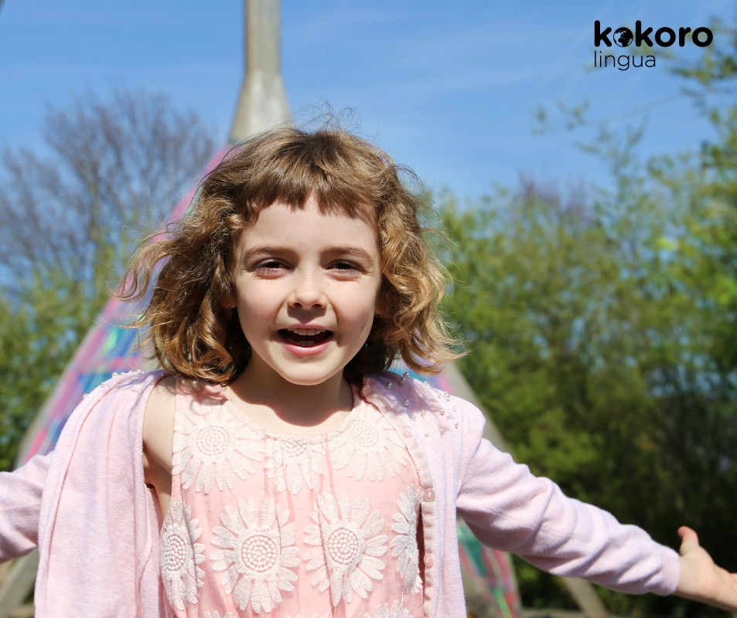

PRESS RELEASE
Coronavirus :
KOKORO lingua, the innovative method for teaching English to children from 3 to 8 years old, offered for 1 month
Dossier de presse | CLIENT
1

Slide 2
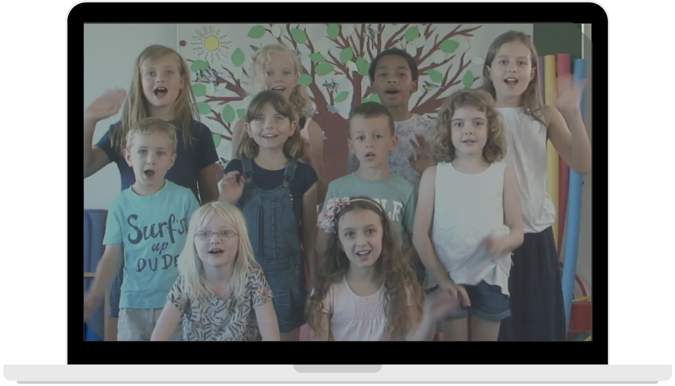
Mastering one or more foreign languages is today an essential skill for many professions. Learning a language also means developing mental flexibility, understanding different ways of thinking and being more open to others.
Numerous studies show the heightened potential of children before the age of 8 in the perception and reproduction of different languages. If these abilities are not activated, they will eventually regress, and the child will have more difficulty hearing and therefore reproducing the different tones of a language.
With KOKORO lingua, the English teachers... are children, who are native English speakers! This learning method is unique, implicit and emotional.
When schools are closed, parents try to simulate a classroom environment best they can and are careful to keep their children occupied as intelligently as possible.
What if they took the opportunity to teach their children English?
It is to help parents, and to give children from 3 to 8 years old the extraordinary chance to learn English that the KOKORO lingua team has decided to make its innovative and multi-awarded method, free for 1 month, via 4 videos
How does it work?
Every week, the children watch a 10-minute video accessible via a secure platform.
Each video is viewed at least 3 times: this is essential for assimilation... and the children never get tired of it!
Each session is accompanied by small games to be played together to anchor the learning in movement.
Each video starts with a movement to facilitate concentration.
In one year, the child assimilates 250 words and expressions of the common English language which they pronounce with the right accent thanks to their little native English-speaking teachers.

Slide 3

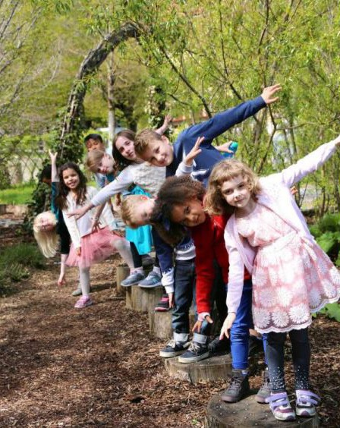
6-year-old English mini-teachers for a
"happy confinement"
To put an end to the challenging "language blockage" experienced by older students and adults, it is very important to start early. Before the age of 8, children have the easiest time to develop their brain plasticity, which is essential to boost their ability to learn languages such as English.
They progress very quickly, and soon are able to pronounce the different tones and accents of Shakespeare's language.
It gets even better: learning English can be joyful, fun and addictive! The KOKORO lingua method has already won over more than 50,000 children thanks to its unique pedagogy:
the teachers are 6-year-olds!

Slide 4

An exclusive Swiss educational innovation inspired by Montessori, awarded the Gold Medal at the Lepine International
In a few words, the KOKORO lingua method is...
Fun and enjoyable: children will love learning English!
A precise educational path created by experts and a multidisciplinary team
A caring and humane approach, without pressure, which is also inspired by the Montessori model and the Cambridge First program.
Learning at the child's own pace, in a gentle manner.
A pedagogical innovation based on peer learning.
Award winning: winner Early Years Resource, GESS Education awards Dubai 2020, Finalist 2019 and 2020 at the BETT show in London and also supported by the French Ministry of Education (Gold Medal Concours Lépine International 2018)
A tool that uses the principles of positive psychology to develop self-confidence, autonomy and joy through experience
KOKORO lingua uses the universality of emotional intelligence to teach English to children from 3 to 8 years old.
«Children learn with other children, native speakers of the language, by sharing with them reciprocal emotions. Our method has been specially designed to allow room for the magic and creativity of children”
Says Nathalie Lesselin, the creator of this method
Small games also help to learn each concept thanks to targeted movements. Indeed, the child is always active: facing the screen, he is invited to play, dance, move and meditate with simple and reassuring rituals.
According to research published by HEC Montréal, the retention rate for peer-to-peer teaching is 90% 24 hours after the course. The student is active and reflective, which is what allows this retention rate to be much higher than other methods.
And the results are there: in one year, children learn an average of 250 words.

Slide 5
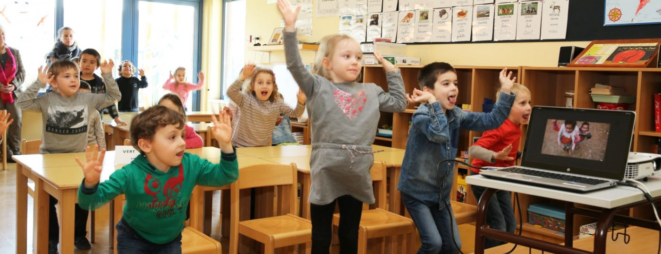
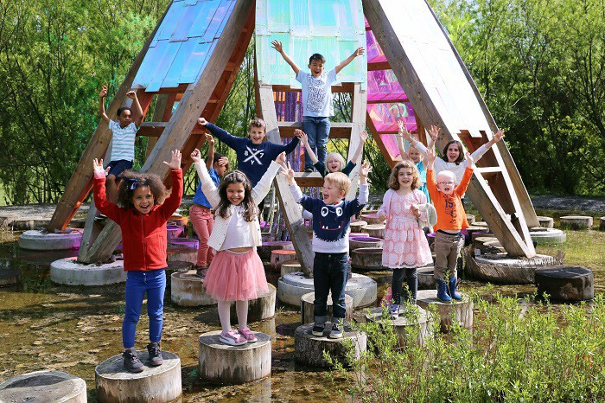
A special offer to support families during confinement
Users’ testimonials
Because it is not always easy to keep children intelligently occupied during confinement, KOKORO lingua offers families and schools 4 videos to learn English for FREE.
The children will thus continue to be accompanied in their development during this delicate period, in a joyful and positive way.
Thereafter, true to its solidarity approach, KOKORO lingua will continue to offer a complete one-year program to a family or school in difficulty, for each program purchased (price: 119€/year for families, 295€/year for schools).
Crédit photo : L’Alsace – Jean-François Frey
SEE THE VIDEO
The Children
"It makes me want to keep learning.”
Valentino
"I love these videos, it's so cool, my English teacher is my age! I feel like I'm learning with friends. I already know how to say: Hello, my name is Leila!”
Leila
"I find it very funny. And also, it's very cool because there are kids who speak English and every week, we change the video.”
Joshua
"I like KOKORO, it helps me learn English. The children, they talk and then I do the same thing.”
Lily-Rose

Slide 6
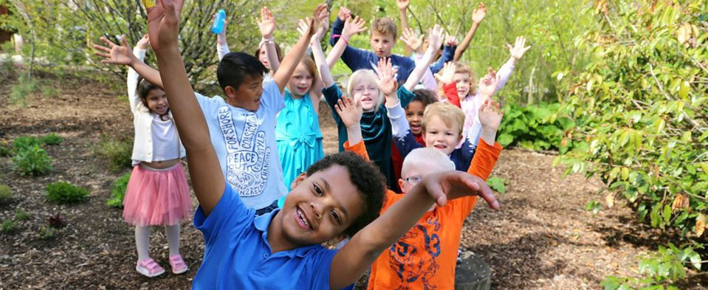

The Teachers
"One of the students who doesn't usually like English classes, watched the video with his friend and after he joined in the small group as usual. His participation was more voluntary, he practiced on his own, which he didn't do before! For the shyer student, it was a great victory.”
Camille and Amélie
"That's great! The students are delighted and ask to see the video again. Teaching becomes a real pleasure again when you see the excitement and joy it brings.”
Christiane
The parents
"Today, Sunday, I hadn't planned to watch the video. Then at 5:30 pm (usual viewing time), Leon (3 and a half) went to get 2 glasses of water, put them on the table and said "Mom, we haven't done KOKORO today yet!!" That says it all!”
Anne
"I think the learning approach is excellent. My two children, aged 5 and 8, are now motivated to learn English. They are the ones who ask me when we are going to watch the video! They are having fun learning. Bravo, the concept is great.”
Robert
"Hello, hello, what's your name? That's it, Nil's starting English. And how do we know that the method is great!? When he sings happily under the sun without realizing it.”
Laria
"Excellent video. At the time of relaxation my boys count to 10 in English naturally, as in a previous video. It's great!”
Emilie
"The parents are enthusiastic. Our school has always been open to innovative projects. The strength of the KOKORO concept is its playfulness. There is no pressure for results, we don't ask anything from the students except to enjoy watching the videos.”
Isabelle
"We are very satisfied with this adventure. The sessions are really well constructed: we appreciate the rhythm of these activities. It creates a pleasant routine for us and the children. A school day must be a day with KOKORO!”
Elise

Slide 7
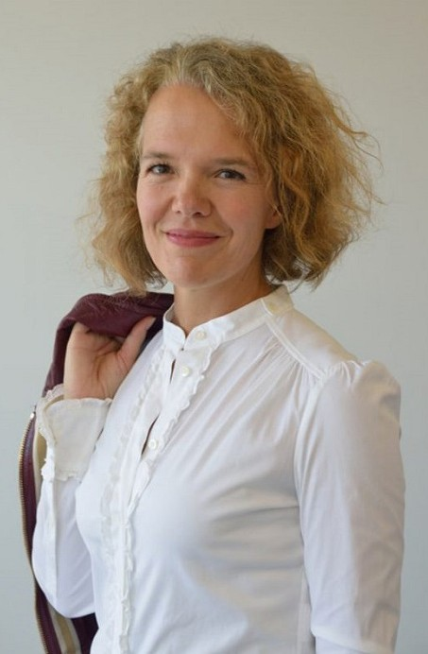
About Nathalie Lesselin, founder of KOKORO lingua
After her higher education, Nathalie followed an international career in large groups (Kenzo LVMH, Gucci Timepieces in Switzerland). She then accompanied the transformation of a small French start-up in the medical sector for 5 years, which has since become the national leader.
As a child, she dreamed of being a schoolteacher or working in a non-governmental organisation in Africa. In short: to do a job that gives meaning to her actions and allows her to make her own contribution to try to create a better world.
So when she had an accidental fall soon after her 40th birthday, with 8 months to recover, she realized that this ordeal was also a gift of life. Another path opened up... Nathalie wondered about the essentials in life and reconnected with her deepest self.
"It was as if I was at a crossroads where everything came together: my childhood memories, Japan, my passion for languages, children, neurosciences, my skills, the rich professional experiences I had lived through... everything made sense! What was supposed to be an ordeal was finally a rebirth.” Nathalie Lesselin
Thinking back to a book she was reading when she was 16, KOKORO or Natsume SOSEKI's Poor Men's Heart, she has the idea of a language learning project for children aged 3 to 8 years old.

Slide 8
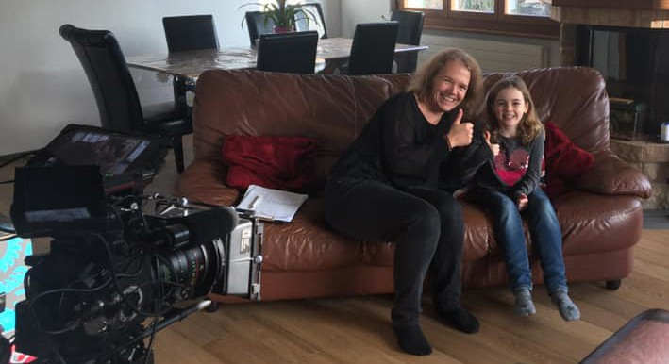
Mother of 2 boys, Nathalie then founded the non-profit association BIG BANG Generation, which aims to promote and disseminate an ideal of universality through education and the promotion of foreign language awareness, the promotion of diversity, and the protection of the environment. The KOKORO lingua project has one key objective: to connect all children with each other, whatever their origin.
«Speaking the same language as another child helps them to be less afraid of other children and it breaks down barriers . »
TO FIND OUT MORE
Website : https://kokorolingua.com/
 https://www.facebook.com/kokorolingua/
 https://instagram.com/kokorolingua/
 https://www.linkedin.com/company/kokoro-lingua/
Today, KOKORO lingua's ambition is to reach as many children as possible around the world. To this end, the videos are accessible to children all over the world. At the same time, KOKORO lingua is also preparing the adaptation of its program in other languages.
In the long term, more technology will be developed to accompany the child in his or her learning, while taking care to support and respect his or her development.
PRESS CONTACT
Nathalie Lesselin
E-mail : info@kokorolingua.com
Tel : +41 766 901 176

